Slide 1
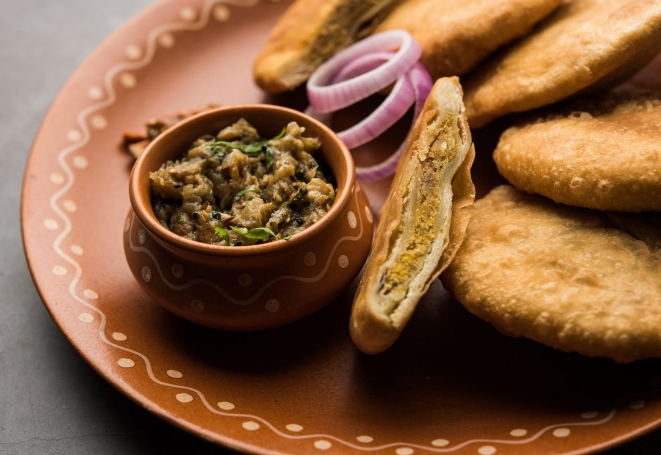
BHOJ
The culinary exchange and selling club

Slide 2
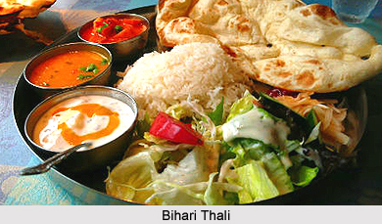
The focus here is not just on buying and selling but on fostering a sense of community and culinary exploration among students.
Here are the key features:
*Homemade Meal Listings:*
- Students can list their homemade meals with descriptions, images, pricing, and dietary information.
- Specify the type of meal (breakfast, lunch, dinner) and availability schedule.
This Photo by Unknown author is licensed under CC BY-NC-ND.

Slide 3

*Meal Exchange Marketplace:*
- In addition to buying meals, students can propose meal exchanges. For example, they can offer to swap their homemade litti chokha for someone else's homemade churma.
- A matchmaking algorithm pairs students based on their meal preferences, facilitating a culinary exchange.

Slide 4
*Dietary Preference Filters:*​
- Include filters for dietary preferences (vegetarian, vegan, gluten-free, etc.) to help users find suitable meals or exchanges.​

Slide 5
Ordering System:
- Allow for direct purchasing of meals or meal exchanges, including payment processing.

Slide 6
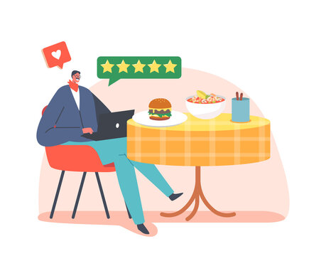
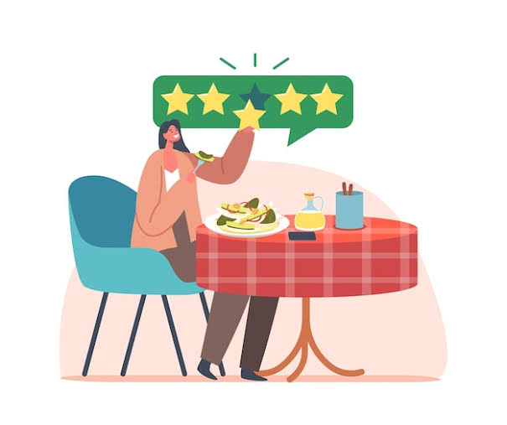
Meal Reviews and Ratings:
- Encourage users to leave reviews and ratings not only for the taste but also for the overall experience of the meal exchange.

Slide 7

Recipe Sharing:
-Recipe sharing could also be used as a tool for proposing meal exchanges.
- Let users share their favorite recipes, creating a community cookbook.

Slide 8
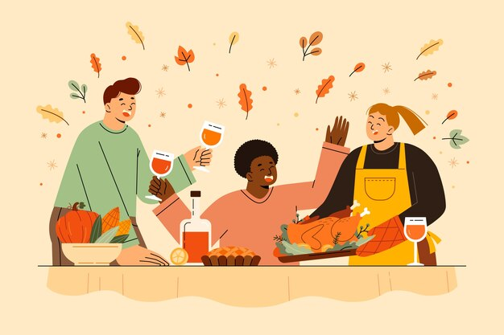
Community Forums:
- Create discussion forums where users can chat about their culinary experiences, share tips, or discuss food-related topics.

Slide 9
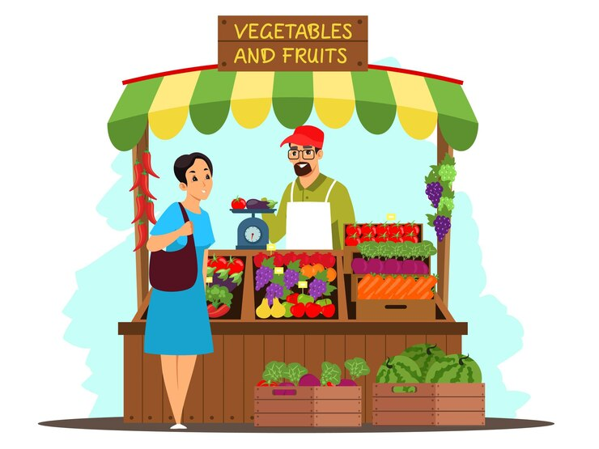
Local Food Marketplace
- Allow students to source fresh and local ingredients for their homemade meals from fellow students or local farmers.

Slide 10
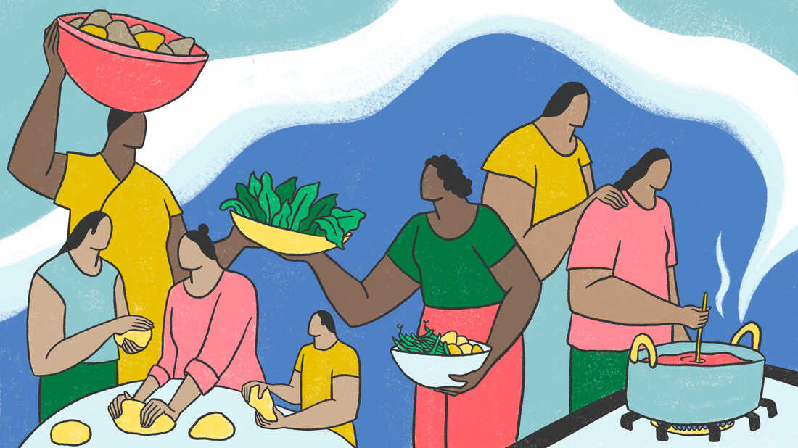
Cultural Exchange:
- Promote cultural exchange by encouraging students from different backgrounds to share their traditional dishes and cooking techniques.

Slide 11

*Sustainability Initiatives:*
- Encourage the use of sustainable practices, such as reducing food waste or sourcing local and organic ingredients.

Slide 12
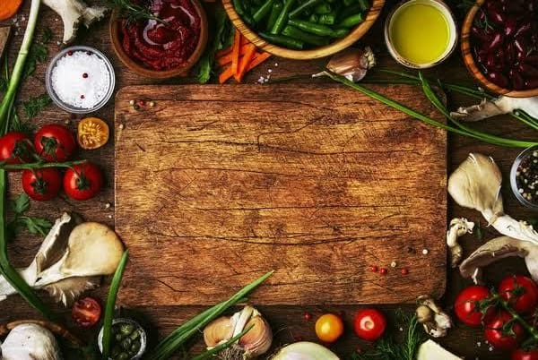
This "Culinary Exchange and selling Club" concept adds a unique social and cultural dimension to our platform. It's not just about buying and selling meals but also about connecting with peers, learning about different cuisines, and building a community of food enthusiasts on campus.

Slide 13
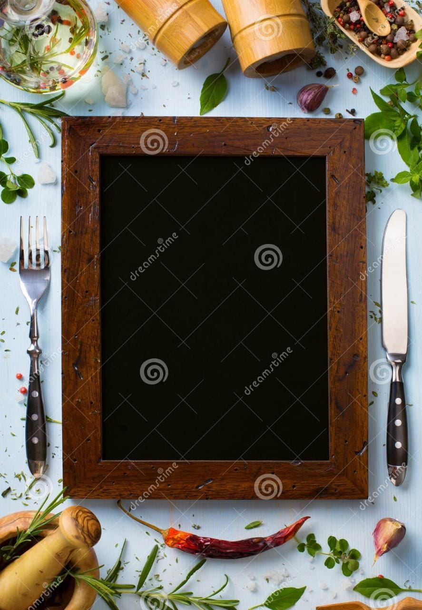
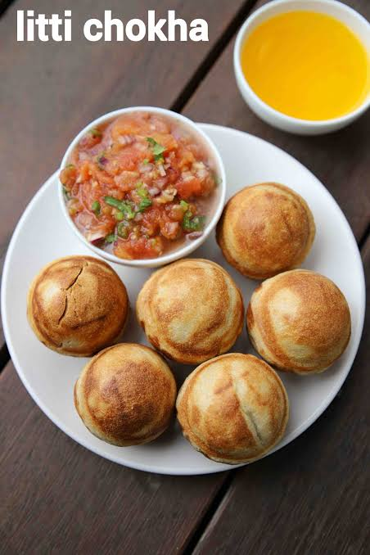
Thank you for ordering from
"BHOJ"

